Slide 1
Case Study 5: Beware the Canadians!
Group 4: Candice Kasahara, Ian Troidl, Tev’ye Davis

Slide 2
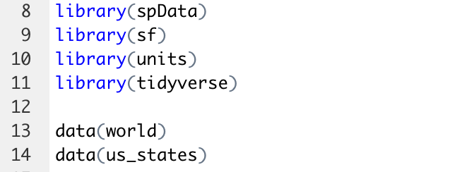
Install packages and download datasets

Slide 3
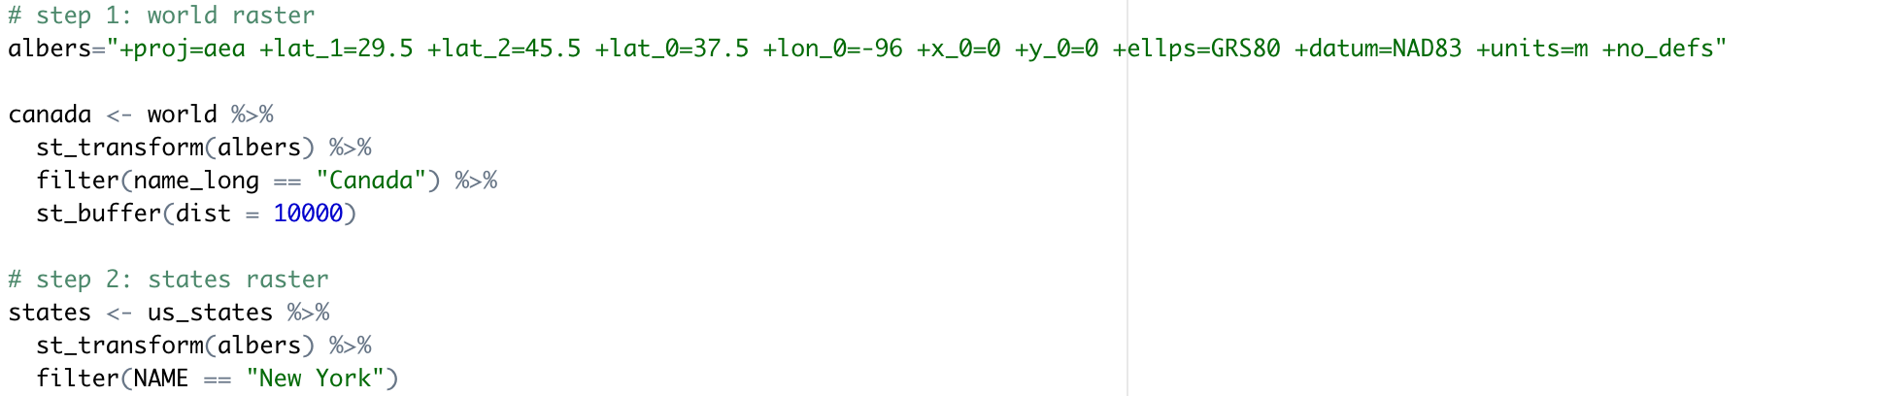
Create raster datasets
Albers equal area projection

Slide 4
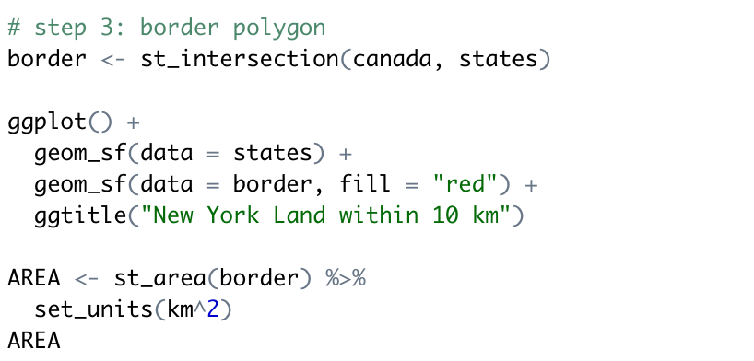
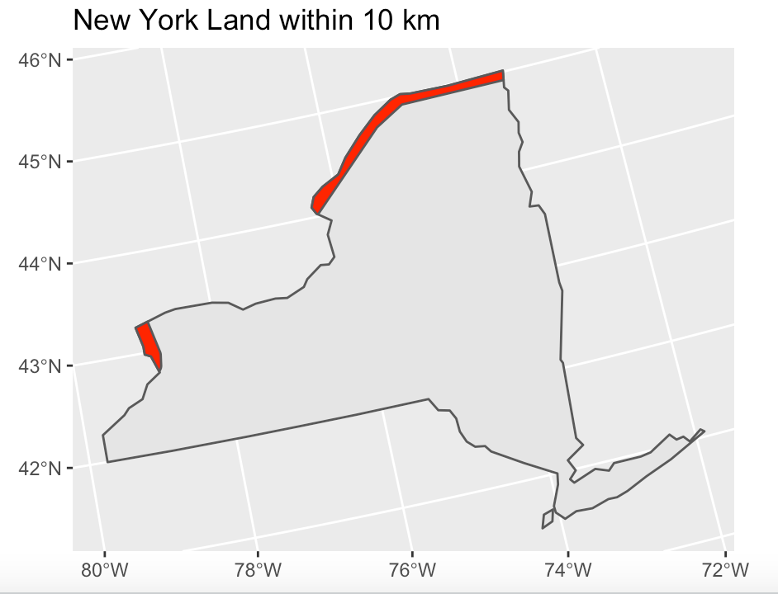
Plot NYS with a 10 km border

Slide 5
How much land do we need to defend from the Canadians?
We have to defend 3,495 km of land against the Canadians!

